Slide 1
CS487P
Database Benchmarking
Project Part 3
Jianqiang Hao & Zhi Zhang

Slide 2
Which systems?
PostgreSQL
Indexed system
Open source
With a rich features set
Hosted on PSU server
MySQL
Indexed system
Open source
Has less features
Hosted on PSU server

Slide 3
Benchmark Approach
Goal: The purpose of our experiment is to analyze the two most popular database systems and find the most suitable application environment for them. Use performance differences with different tasks to gain a better understanding of different database system.
Method: Using sql queries to execute in ONEKTUP, TENKUP1, and TENKUP2 to test equality-base query, range-base query, join algorithm, aggregation performance and bulk updates. We perform 5 times for each sql statement, then drop the highest and lowest experiment’s result, get the average of rest.
*In order to isolate the hardware factor as well as possible, we chose to run experiments on both DBMS hosted by PSU server, and keep the default configuration.

Slide 4
1. Equality-based and range-based
Goal: Compare equality-based query and range-based query performance across systems.
Expectation: We expect they will have similar query execution time, because they probably would use the similar index(B-tree and hash) to plan the query
Method:
Query a: select * From relation where unique1 between 0 and 99;
Query b: select * From relation where unique1 = 105;
Using a 10,000 tuple relation (TENKTUP1).

Slide 5
Execution time:
Query a: Query b:
Times | MySQL | Postgres
high | 5.40ms | 21.19ms
low | 4.10ms | 10.19ms
avg. | 4.63mw | 16.28ms
Times | MySQL | Postgres
high | 15.50ms | 10.13ms
low | 10.90ms | 3.48ms
avg. | 12.33ms | 4.67ms

Slide 6
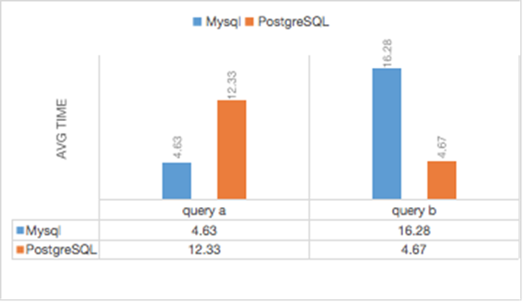
Chart(unit: ms)
Learned: Mysql would have a better performance on equality-based query but a worse performance on range-based query than postgresql when dealing with a 10,000 size table.

Slide 7
2. Join algorithm performance
Goal: This experiment compares join algorithm performance on two selected systems. Also, look at the query execution plans and report what types of joins the systems use.
Expectation: We expect PostgreSQL would have a better performance, because it probably would use hash join to execute the query which MySQL won’t.
Method:
Use Wisconsin Benchmark queries 10,11
Single join on onektup and tenktup
Multiple join on a 1k relation and two 10k relations

Slide 8
Execution time:
 | Query 10 |  | Query 11
Times | MySQL | Postgres | MySQL | Postgres
high(ms) | 14.00 | 188.95 | 1715.00 | 214.62
low(ms) | 9.60 | 116.10 | 1624.00 | 185.41
avg(ms) | 10.97 | 146.20 | 1675.67 | 203.37

Slide 9
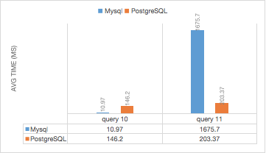
Chart:
Learned: Just as our expectation, Mysql chose to use blocked nested loop join to executes both query, which would have a better join performance when dealing with small amount of data, but Postgresql chose to use hash join to execute both, which performs better on huge amount of data.

Slide 10
3. Aggregation performance and scalability
Goal: This experiment tests the performance for each system using sum(), count() in different size files.
Expectation: We expect the execution time would grow faster when the table size reach a certain threshold, which the buffer pool can’t fit the table anymore.
Method:
Query A: Select count(*) from relation Group by four
Query B: Select sum(two) from relation Group by four
Using a 100,000 tuple, a 10,000 tuple relation (TENKTUP1), and a 1000 tuple relation.

Slide 11
Execution time:
Select count(*) from `relation` Group by four;
 | ONEKTUP |  | TENKTUP1 |  | HUNDKTUP
Times | MySQL | Postgres | MySQL | Postgres | MySQL | Postgres
high(ms) | 3.50 | 6.47 | 15.00 | 11.74 | 90.00 | 78.09
low(ms) | 2.10 | 1.89 | 10.20 | 5.56 | 65.70 | 71.00
avg(ms) | 3.07 | 3.44 | 11.87 | 7.04 | 69.10 | 71.96

Slide 12
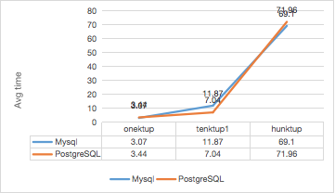
Chart: Select count(*) from `relation` Group by four;
Learned: for both systems the execution time of aggregation would grow faster when the table size have reached a certain threshold, which the buffer pool can’t fit the table anymore.

Slide 13
4. Bulk updates with different selectivities
Goal: Test the bulk update performance of two selected systems, using queries with 25% selection, 50% selection, 100% selection.
Expectation: We expect the query execution time of both systems won’t be similar, because they have totally different buffer structures.
Method:
25% selection: Update TENKTUP1 Set two = 0 Where four = 1;
50% selection: Update TENKTUP1 Set four = 0 Where two = 1;
100% selection: Update TENKTUP1 Set four = 0 Where two >= 0;
Using a 10,000 tuple relation (TENKTUP1).

Slide 14
Results:
 | 25% selection |  | 50% selection |  | 100% selection
Times | MySQL | Postgres | MySQL | Postgres | MySQL | Postgres
high(ms) | 33.00 | 293.53 | 29.40 | 157.04 | 55.80 | 118.76
low(ms) | 24.80 | 43.25 | 24.00 | 33.75 | 39.40 | 109.88
avg(ms) | 27.97 | 112.97 | 26.37 | 53.67 | 43.13 | 115.59

Slide 15
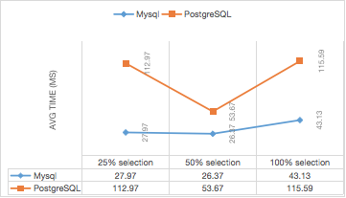
Chart:
Learned: From our experiment, we observed that mysql had better bulk update performance for all three different selectivities than and had a steady growth curve(approximately linear), which Postgresql doesn’t have.

Slide 16
Conclusion
Equality based query(10k relations): Postgresql win
Range based query(10k relations): Mysql win
Join query
1k join 10k: Mysql win
1k join 10k join 10k: Postgresql win
Aggregation query: Tie
Bulk update: Mysql win

Slide 17
Lessons learned
MySQL could be more suitable for online transactions because it takes less time to search in scope, and PostgreSQL could be more suitable for large and complex analysis processes.
During the system research, we found that the architecture for both systems are far more complicated than our expectation, like Mysql would have a storage engine(e.g. innodb), and many different buffer pool for different uses etc. therefore, the optimization of a DBMS would always require tons of tedious tuning based on the actual situation.

